Slide 1


A CENTER FOR INTER-DISCIPLINARY RESEARCH 2021-22
TITLE
SMART DUSTBIN
SUPERVISED BY
B V S NITHIN, G V MAHATI
GOKARAJU RANGARAJU
INSTITUTE OF ENGINEERING AND TECHNOLOGY AUTONOMOUS

Slide 2
Advanced Academic Center
( A Center For Inter-Disciplinary Research )
This is to certify that the project titled
SMART DUSTBIN
is a bonafide work carried out by the following students in partial fulfillment of the requirements for Advanced Academic Center intern, submitted to the chair, AAC during the academic year 2021-22.
RO
NAME | ROLL NO | BRANCH
ENDRAPU KRANTHI RAJ | 21241A04E8 | ECE
V DINESH CHANDRA | 21241A0558 | CSE
2

Slide 3
This work was not submitted or published earlier for any study
Ms. G V Mahati | Dr.B.R.K.Reddy | Dr.G.Ramesh
Mr. B. V. S Nithin
Project Supervisors | Program Coordinator | Associate Dean,AAC

Slide 4
ACKNOWLEDGEMENTS
We express our deep sense of gratitude to our respected Director, Gokaraju Rangaraju Institute of Engineering and Technology, for the valuable guidance and for permitting us to carry out this project.
With immense pleasure, we extend our appreciation to our respected Principal, for permitting us to carry out this project.
We are thankful to the Associate Dean, Advanced Academic Centre, for providing us an appropriate environment required for the project completion.
We are grateful to our project supervisor who spared valuable time to influence us with their novel insights.
We are indebted to all the above mentioned people without whom we would not have concluded the project.

Slide 5
TABLE OF CONTENTS
1. ABSTRACT………………………………………….6
2. INTRODUCTION…………………………………....6
3. PROJECT WORKFLOW……………………………7
4. HARDWARE USED…………………………………7--9
    4.1 ESP 32..........................................................7
    4.2 ULTRASONIC SENSOR.............................8
    4.3 SOIL MOISTURE........................................8
    4.4 SERVO MOTOR..........................................9
  5. SOTWARE USED…………………………………9--10
    5.1 ARDUINO IOT CLOUD…………………9
    5.2 ARDUINO IDE……………………………10
6. CODE……………………………………………….11—15
7. References..................................................................16
8. Website…………………………………………….16
9. APP…………………………………………………17
10. CONCLUSION……………………………………18
11. FUTURE DEVELOPMENTS …………………….18

Slide 6
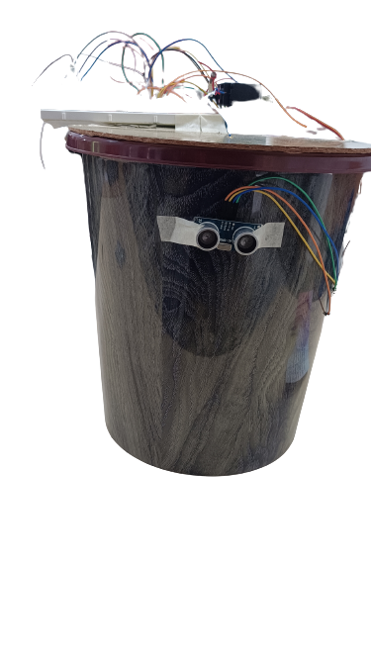
ABSTRACT
CLEAN INDIA GREEN INDIA is what we hear most these days,
As per reaches in INDIA 62 million tonnes of wastes is produces which is very hard to separating wet waste and dry waste
The main objective of this project is to design a smart dustbin which will help in keeping our environment clean and also eco friendly. We are using soil moisture sensor to know the moisture of the waste by which we can separate the waste and then store it differently.
Our system is built using ESP32, Ultrasonic sensor , servo motor and soil moisture sensor.
INTRODUCTION
Dustbin is the storage container used for disposing waste by each and every person in the world. The main thing they look in their surroundings for disposing waste is the dustbin. Smart Dustbin is just a normal bin where everyone can dispose waste but integration of some hardware components is done for more efficient use of it. Smart Dustbin is integrated with some hardware components such as ESP32, Servo Motor, Ultrasonic sensors and Soil sensors. These components help in help in separating the dry and wet waste which will in turn help an eco-friendly environment.
We have used the AURDIONE IDE for the software development.
This equipment will help in separating the waste and storing it differently which can help us in fast biodegrading and recycling of waste.

Slide 7
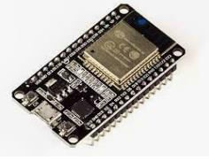
PROJECT WORK FLOW
ESP32 has been used as the base of the project, to give commands and receive signals.
A person standing within 30cm radius of the dustbin is observed by the ultrasonic sensor and a command is passed to the ESP32, from ESP32 a command is send to servo motor to rotate the cap of the bin, when the person puts in the waste in the bin and then the moisture level is checked by the soil-moisture sensor and the waste is categorized as dry or wet based on the moisture level and is separated.
There is app and website is available which shows the moisture level of the waste and weather the waste is wet or dry.
HARDWARE USED
ESP32
ESP32 is a low-cost System on Chip (SoC) Microcontroller from Espressif Systems, the developers of the famous ESP8266 SoC. It is a successor to ESP8266 SoC and comes in both single-core and dual-core variations of the Tensilica’s 32-bit Xtensa LX6 Microprocessor with integrated Wi-Fi and Bluetooth.
The good thing about ESP32, like ESP8266 is its integrated RF components like Power Amplifier, Low-Noise Receive Amplifier, Antenna Switch, Filters and RF Balun. This makes designing hardware around ESP32 very easy as you require very few external components.
ESP32

Slide 8
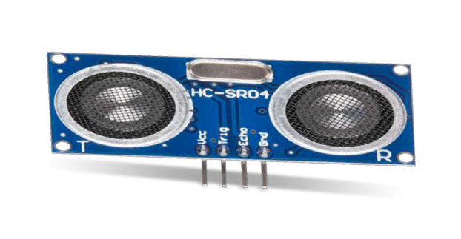
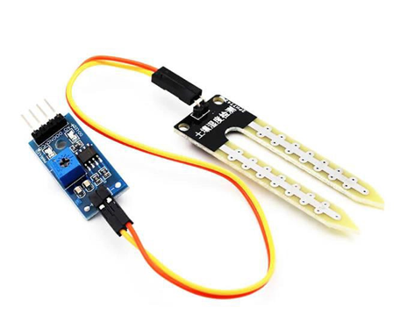
ULTRASONIC SENSOR
An ultrasonic sensor is an electronic device that measures the distance of a target object by emitting ultrasonic sound waves, and converts the reflected sound into an electrical signal. Ultrasonic waves travel faster than the speed of audible sound (i.e. the sound that humans can hear). Ultrasonic sensors have two main components: the transmitter (which emits the sound using piezoelectric crystals) and the receiver (which encounters the sound after it has travelled to and from the target). In order to calculate the distance between the sensor and the object, the sensor measures the time it takes between the emission of the sound by the transmitter to its contact with the receiver. The formula for this calculation is D = ½ T x C (where D is the distance, T is the time, and C is the speed of sound ~ 343 meters/second). Ultrasonic sensors are also used as level sensors to detect, monitor, and regulate liquid levels in closed containers (such as vats in chemical factories). Most notably, ultrasonic technology has enabled the medical industry to produce images of internal organs, identify tumors, and ensure the health of babies in the womb
ULTRASONIC
SOIL MOISTURE
Soil moisture sensors measure the volumetric water content in soil. Since the direct gravimetric measurement of free soil moisture requires removing, drying, and weighing of a sample, soil moisture sensors measure the volumetric water content indirectly by using some other property of the soil, such as electrical resistance, dielectric constant, or interaction with neutrons, as a proxy for the moisture content.
The relation between the measured property and soil moisture must be calibrated and may vary depending on environmental factors such as soil type, temperature, or electric conductivity. Reflected microwave radiation is affected by the soil moisture and is used for remote sensing in hydrology and agriculture. Portable probe instruments can be used by farmers or gardeners.
Soil moisture sensors typically refer to sensors that estimate volumetric water content. This has been used in our projects to separate wet waste and dry waste.
SOIL MOISTURE

Slide 9
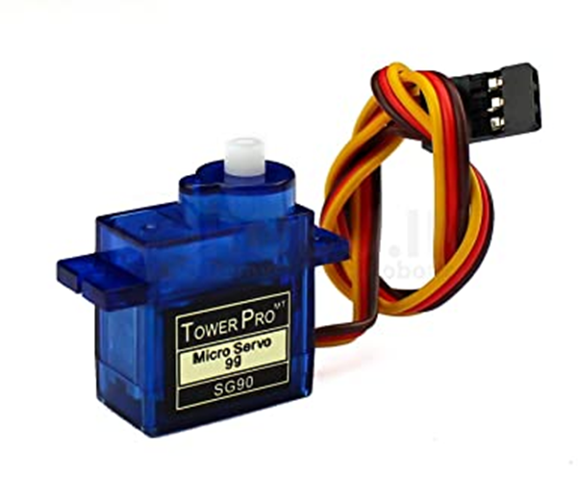
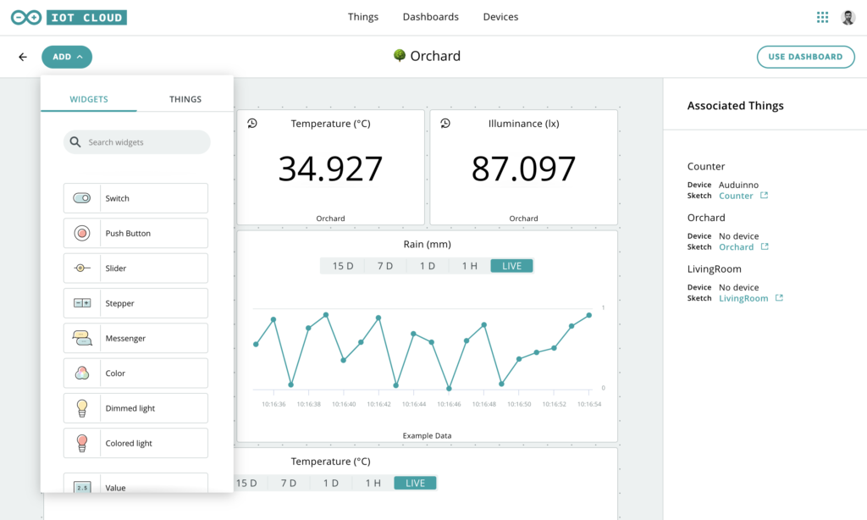
SERVO MOTOR
A servo motor is a rotary actuator that allows for precise control of angular position. It consists of a motor coupled to a sensor for position feedback. It also requires a servo drive to complete the system. The drive uses the feedback sensor to precisely control the rotary position of the motor.
SERVO MOTOR
SOFTWARE USED
ARDUINO IOT CLOUD
The Arduino IoT Cloud is a online platform that makes it easy for you to create, deploy and monitor IoT projects. Arduino Cloud IoT Cheat Sheet. Learn how to set up the Arduino Cloud IoT, get a quick overview of the compatible boards, the API, configuration, Things, variables and dashboards.

Slide 10
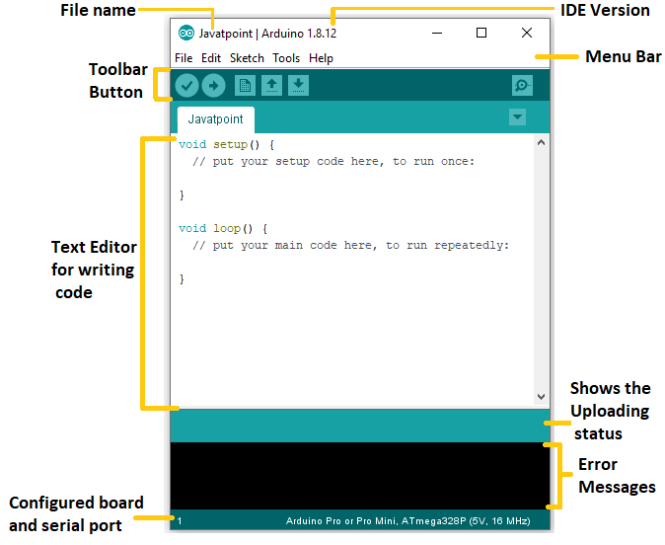

ARDUINO IDE
The Arduino Integrated Development Environment (IDE) is a cross-platform application (for Windows, macOS, Linux) that is written in functions from C and C++. It is used to write and upload programs to Arduino compatible boards. The Arduino board is connected to a computer via USB, where it connects with the Arduino development environment (IDE). The user writes the Arduino code in the IDE, then uploads it to the microcontroller which executes the code, interacting with inputs and outputs such as sensors, motors, and lights. Arduino serial monitor can be opened by clicking on the magnifying glass icon on the upper right side of the IDE or under tools. The serial monitor is used mainly for interacting with the Arduino board using the computer and is a great tool for real-time monitoring and debugging.

Slide 11
CODE
WITHOUT CLOUD
#include<ESP32Servo.h>
#define echoPin 12
#define trigPin 13
int msensor = 33; //Moisture sensor conneced to D27
long duration; //------------> for ultrasonic
long distance; //------------> for ultrasonic
Servo servo1; //------------> servo1 = to open dustbin mouth
Servo servo2; //------------> servo2 = to separate DRY and WET wastes
int pos1,pos2; //------------> pos1,pos2 = angle made by servo1 and servo2
void setup()
{
pinMode(trigPin, OUTPUT);
pinMode(echoPin, INPUT);
pinMode(msensor,INPUT);
servo1.attach(14);
servo2.attach(26);
Serial.begin(115200);
}
void loop()
{
digitalWrite(trigPin, LOW);
delayMicroseconds(2);
digitalWrite(trigPin, HIGH);
delayMicroseconds(10);
digitalWrite(trigPin, LOW);
duration = pulseIn(echoPin, HIGH);
distance = duration * 0.034 / 2;
Serial.print("Distance: ");
Serial.print(distance);
Serial.println(" cm");
if (distance < 30)
{
int value = 0; // for the analog value from moisture sensor Serial.println("Dustbin Open");
// connected servo1 || Red=+ve(middle),Brown=-ve(GND),Orange=PWM
for (pos1 = 0; pos1 <= 100; pos1++) // loop for mouth opening
{ servo1.write(pos1);
delay(15);
}

Slide 12
delay(5000);
value = analogRead(msensor); // Read the analog value from moisture sensor Serial.print("Moisture value: ");
Serial.println(value); //Dumping process
if(value<3000)
{
Serial.println("WET waste Detected");
for (pos2 = 90; pos2 <= 175; pos2++) // loop for dumpimg wet side
{
servo2.write(pos2);
delay(15);
}
delay(5000); //5sec delay for dump fall
for (pos2 = 175; pos2 >= 90; pos2--) // loop for original psition after wet dump
{
servo2.write(pos2);
delay(15);
}
}
else
{
Serial.println("DRY waste Detected");
for (pos2 = 90; pos2 >= 5; pos2--) // loop for dumpimg dry side
{
servo2.write(pos2);
delay(15);
}
delay(5000); //5sec delay for dump fall
for (pos2 = 5; pos2 <= 90; pos2++) // loop for original psition after dry dump
{
servo2.write(pos2);
delay(15);
}
}
delay(1000); // mouth open for 10+20= 30sec
for (pos1 = 100; pos1 >= 0; pos1--) // loop for closing slowly
{
servo1.write(pos1);
delay(15);
}
}

Slide 13
else
{
Serial.println("Dustbin Close");
servo1.write(0);
delay(3000);
}
}
WITH CLOUD
#include "thingProperties.h“
#include<ESP32Servo.h>
#define echoPin 12
#define trigPin 13
int msensor = 33; //Moisture sensor conneced to D27
long duration; //------------> for ultrasonic
long distance; //------------> for ultrasonic
Servo servo1; //------------> servo1 = to open dustbin mouth
Servo servo2; //------------> servo2 = to separate DRY and WET wastes
int pos1,pos2; //------------> pos1,pos2 = angle made by servo1 and servo2
void setup()
{
// Initialize serial and wait for port to open:
Serial.begin(9600);
// This delay gives the chance to wait for a Serial Monitor without blocking if none is found
delay(1500);
pinMode(trigPin, OUTPUT);
pinMode(echoPin, INPUT);
pinMode(msensor,INPUT);
servo1.attach(14);
servo2.attach(26);
// Defined in thingProperties.h
initProperties();
// Connect to Arduino IoT Cloud ArduinoCloud.begin(ArduinoIoTPreferredConnection);

Slide 14
/* The following function allows you to obtain more information related to the state of network and IoT Cloud connection and errors the higher number the more granular information you’ll get. The default is 0 (only errors). Maximum is 4 */ setDebugMessageLevel(2);
ArduinoCloud.printDebugInfo();
}
void loop()
{
ArduinoCloud.update();
digitalWrite(trigPin, LOW);
delayMicroseconds(2);
digitalWrite(trigPin, HIGH);
delayMicroseconds(10);
digitalWrite(trigPin, LOW);
duration = pulseIn(echoPin, HIGH);
distance = duration * 0.034 / 2;
Serial.print("Distance: ");
Serial.print(distance);
Serial.println(" cm");
if (distance < 30)
{
Serial.println("Dustbin Open");
// connected servo1 || Red=+ve(middle),Brown=-ve(GND),Orange=PWM
for (pos1 = 0; pos1 <= 100; pos1++) // loop for mouth opening
{
servo1.write(pos1);
delay(15);
}
delay(5000);
str1 = analogRead(msensor); // Read the analog value from moisture sensor Serial.print("Moisture value: ");
Serial.println(str1); //Dumping process
if(str1<3000)
{
drywet="Wet waste Detected";
Serial.println("WET waste Detected");
for (pos2 = 90; pos2 <= 175; pos2++) // loop for dumpimg wet side
{
servo2.write(pos2);
delay(15);
}
delay(5000); //5sec delay for dump fall
for (pos2 = 175; pos2 >= 90; pos2--) // loop for original psition after wet dump
{
servo2.write(pos2);
delay(15);
}
}

Slide 15
else
{
drywet="DRY waste Detected";
Serial.println("DRY waste Detected");
for (pos2 = 90; pos2 >= 5; pos2--) // loop for dumpimg dry side
{
servo2.write(pos2);
delay(15);
}
delay(5000); //5sec delay for dump fall
for (pos2 = 5; pos2 <= 90; pos2++) // loop for original psition after dry dump {
servo2.write(pos2);
delay(15);
}
}
delay(1000); // mouth open for 10+20= 30sec
for (pos1 = 100; pos1 >= 0; pos1--) // loop for closing slowly
{
servo1.write(pos1);
delay(15);
}
}
else
{
Serial.println("Dustbin Close");
servo1.write(0);
delay(3000);
}
}

Slide 16
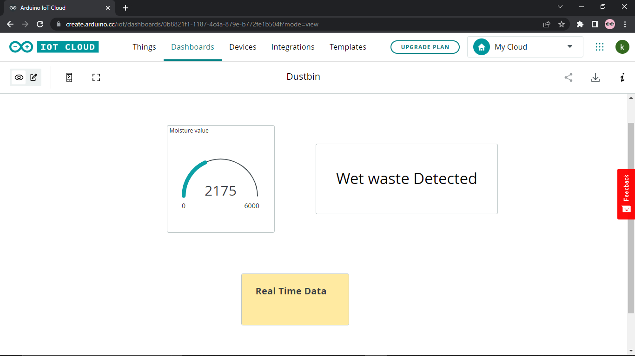
References
1) Waste collected in India.
https://timesofindia.indiatimes.com/readersblog/environmental/indian-landfill-the-ultimate-trash-kingdom-25565/
2) Mixed Landfill
https://www.slrecyclingltd.co.uk/what-are-the-negative-effects-of-landfill/
WEBSITE working model

Slide 17
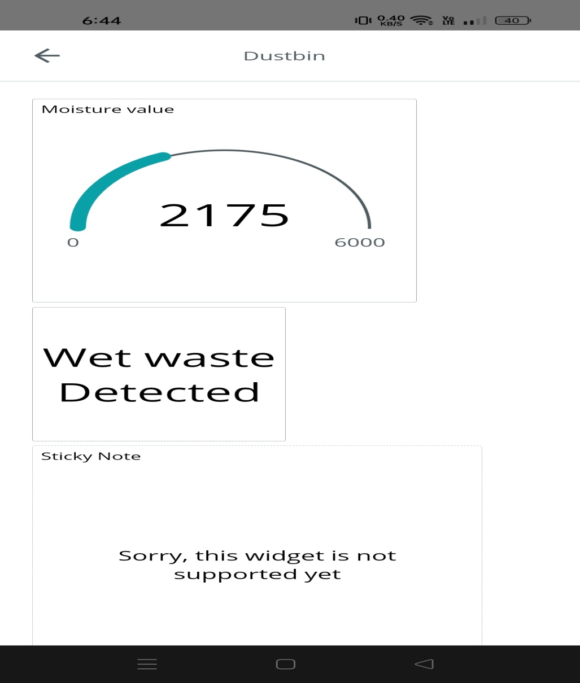
APP working model

Slide 18
CONCLUSION
Here we are going to make an evolution change toward cleanliness. Smart dustbins are better addition for traditional garbage dustbin. It is equipped with smart devices like sensors, ESP32 etc. Lid of the dustbin will automatically open when an object comes near to the dustbin and after certain time period it will close automatically it will help toward health and hygiene and the smart dustbin will also help in reducing the task of separating wet and dry waste, if these are placed in places like canteens and malls etc. people will ensure to put the waste in the dustbin and it will later help in biodegradation and recycling.
FUTURE DEVELOPMENTS
Improving the efficiency of waste segregation.
Including of points system to increase interest in people to use the dustbin.
Creating the bin in a more useful way.
Promoting awareness among people to use dustbin.
Increase the number of bin available for the use.

